Slide 1
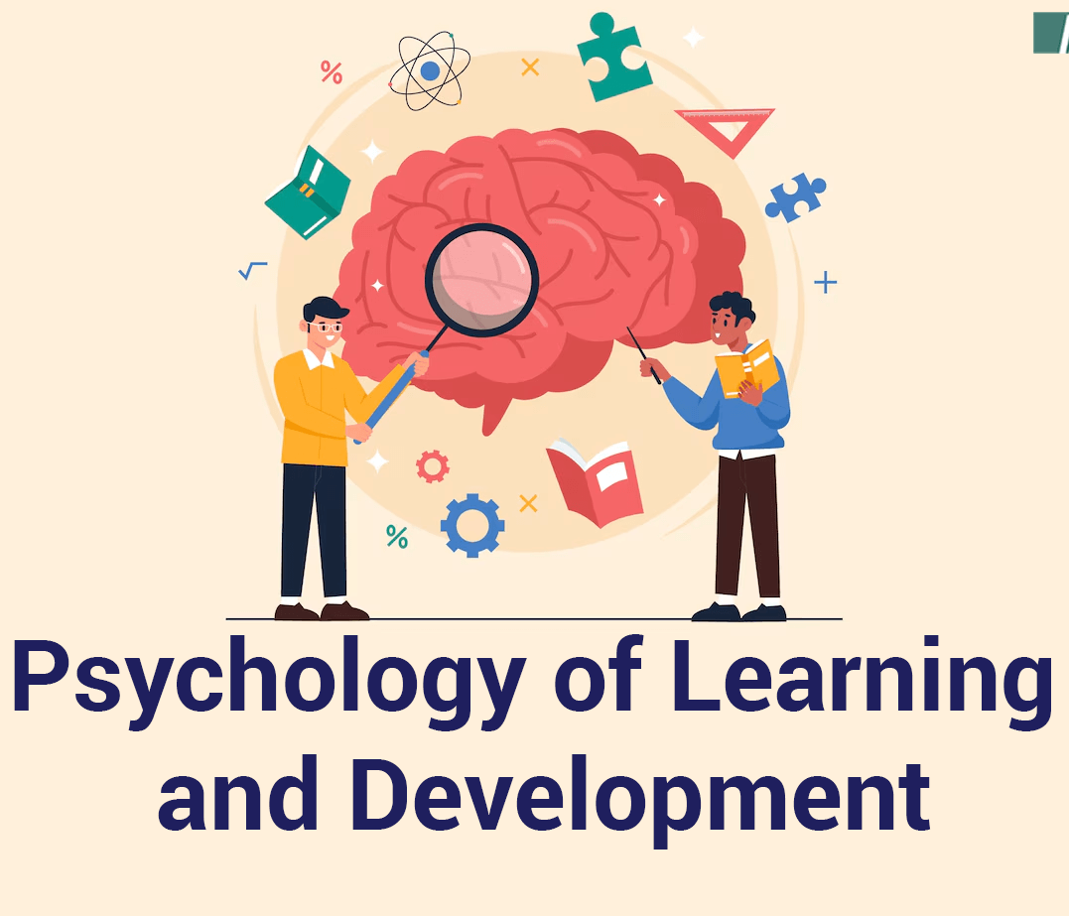
Learning and Development

Slide 2

LECTURE 1

Slide 3

Introduction to Learning
Any relatively permanent change in behavior, produced by experience.
Not temporary
Not maturation
Vicarious and Experience
Not always positive

Slide 4
Classical Conditioning
Ivan Pavlov, a Russian physiologist, discovered it during his work on digestion
Learning that some Stimuli Signal others
Unconditioned Stimulus – elicit a automatic response
Unconditioned Response – automatic response
Conditioned Stimulus – non-neutral stimulus
Conditioned Response – response to CS

Slide 5
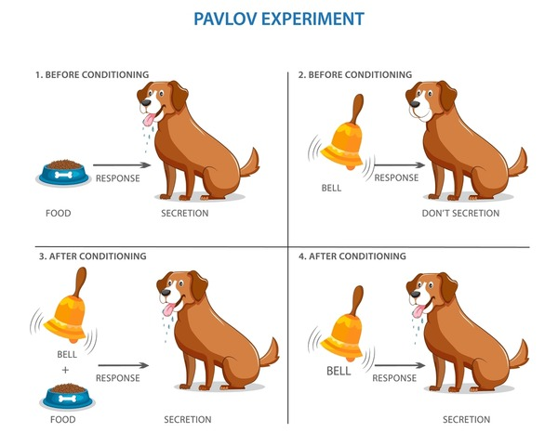

Slide 6
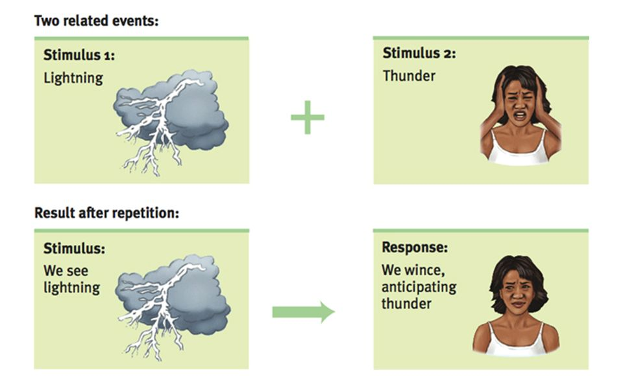

Slide 7
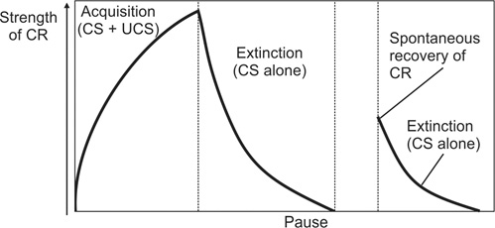
Basic Principles

Slide 8
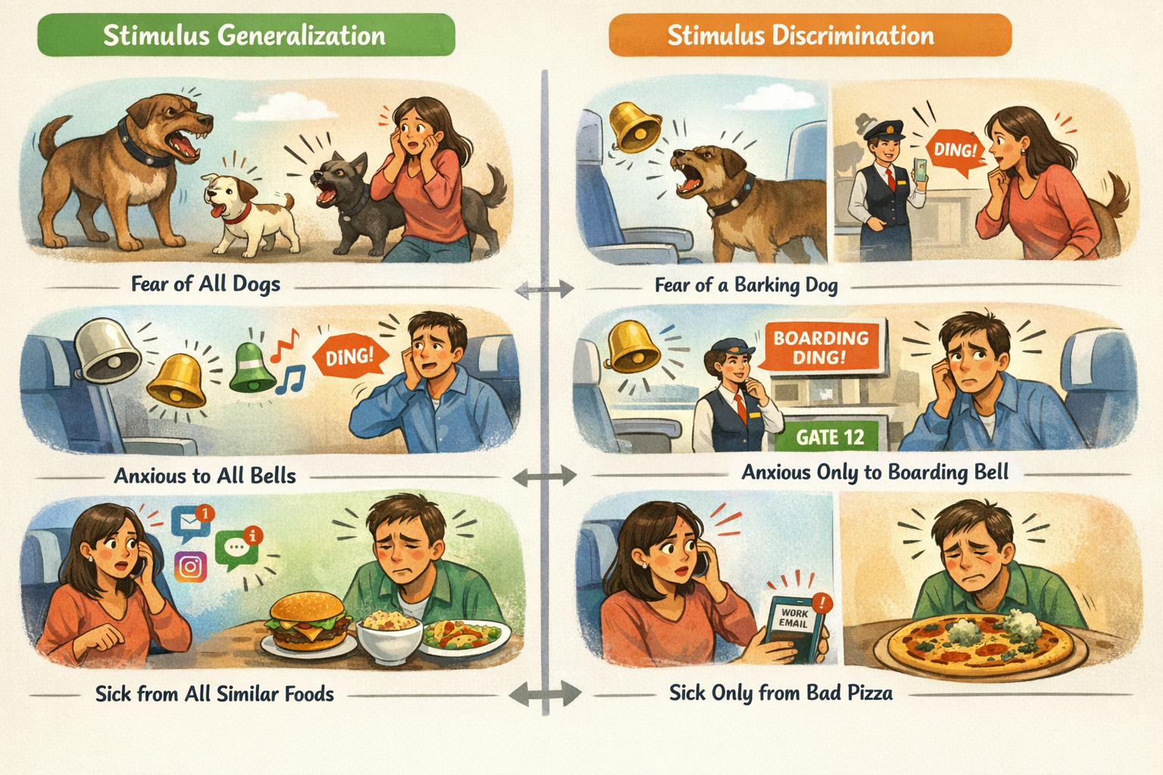

Slide 9
Video
https://www.youtube.com/watch?v=sh80xjAnO-w&t=14s
V1 Classical Conditioning

Slide 10
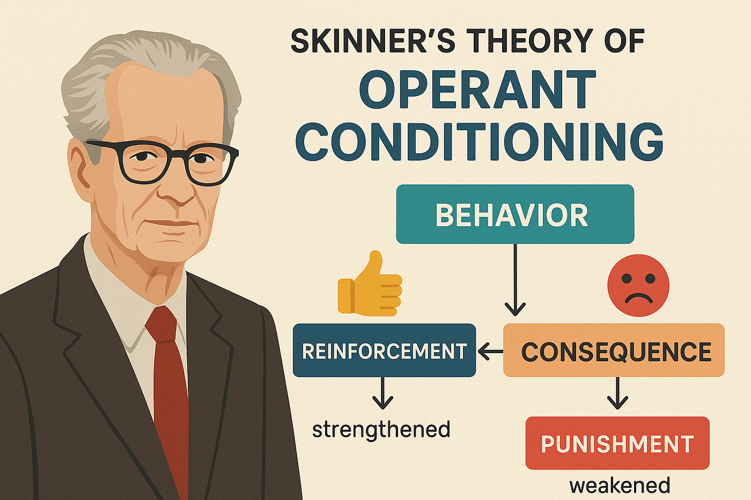
LECTURE 2

Slide 11
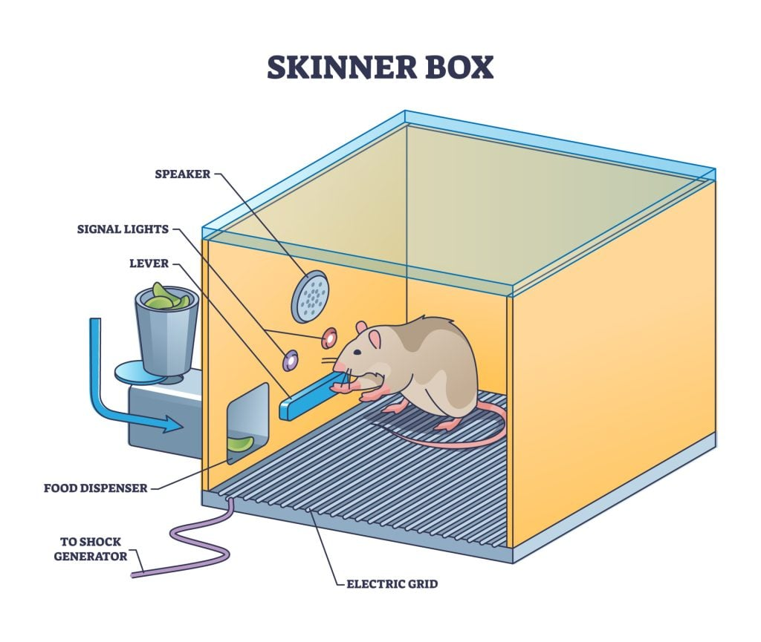
Operant Conditioning
Thorndike later Skinner
Learning Based on Consequences
Yield positive outcomes
Escape negative
Reinforcement
Punishment

Slide 12
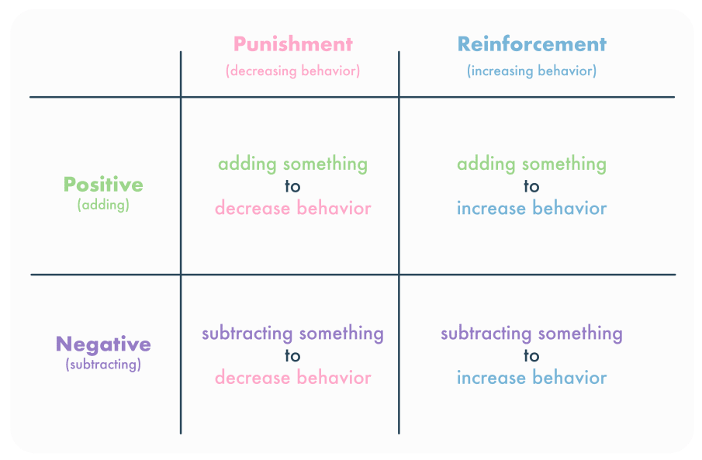

Slide 13
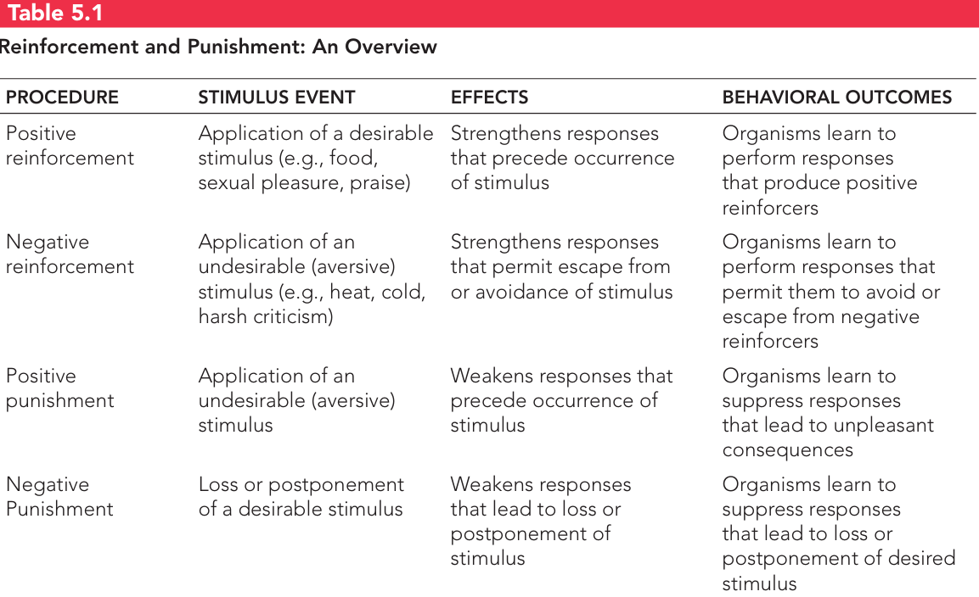

Slide 14
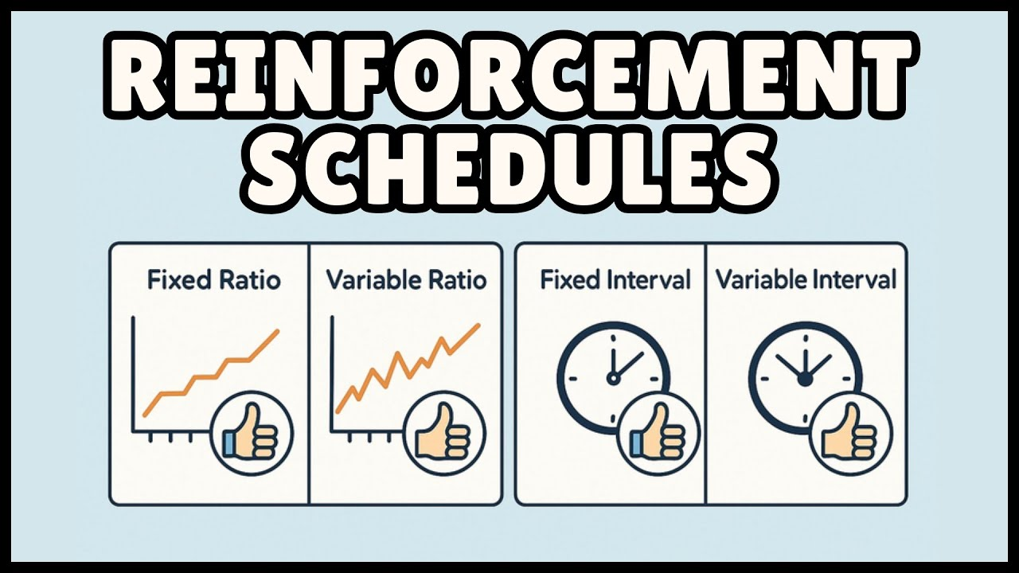

Slide 15
Video
https://www.youtube.com/watch?v=LSHJbIJK9TI
V2 Operant Conditioning

Slide 16
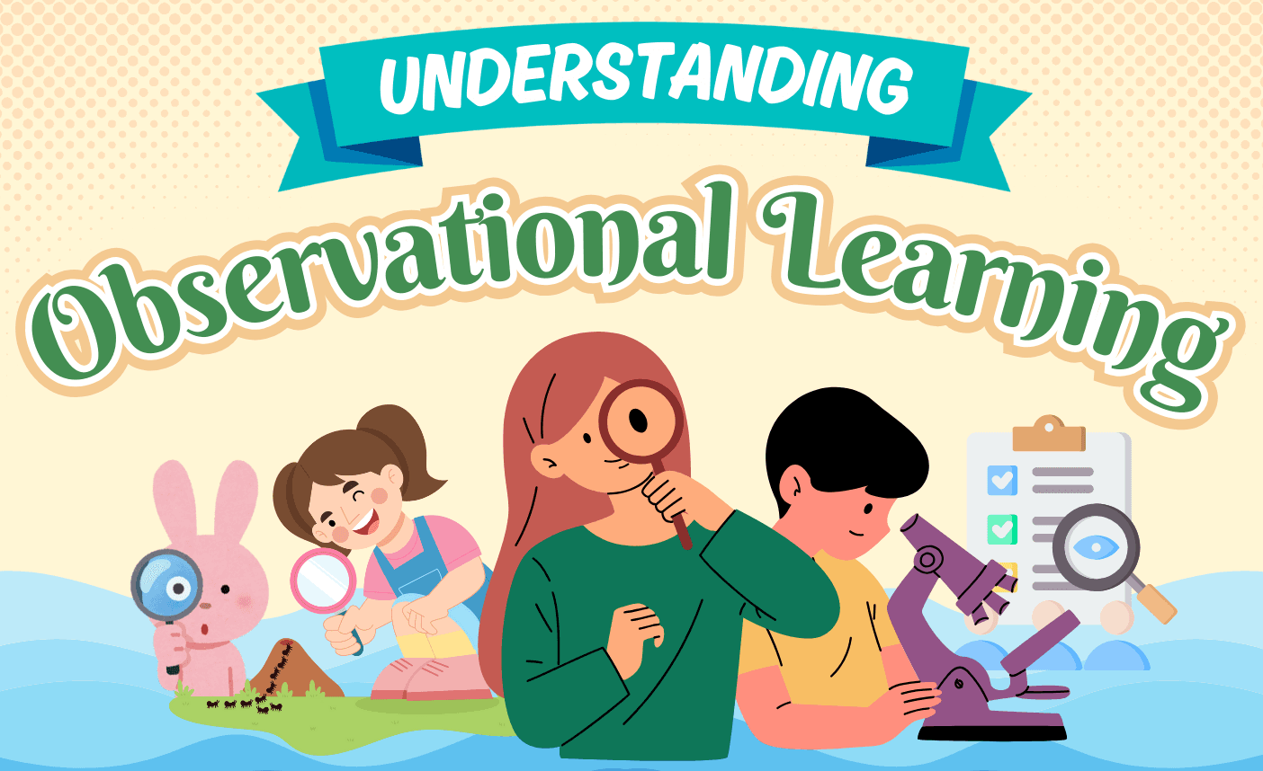
LECTURE 3

Slide 17
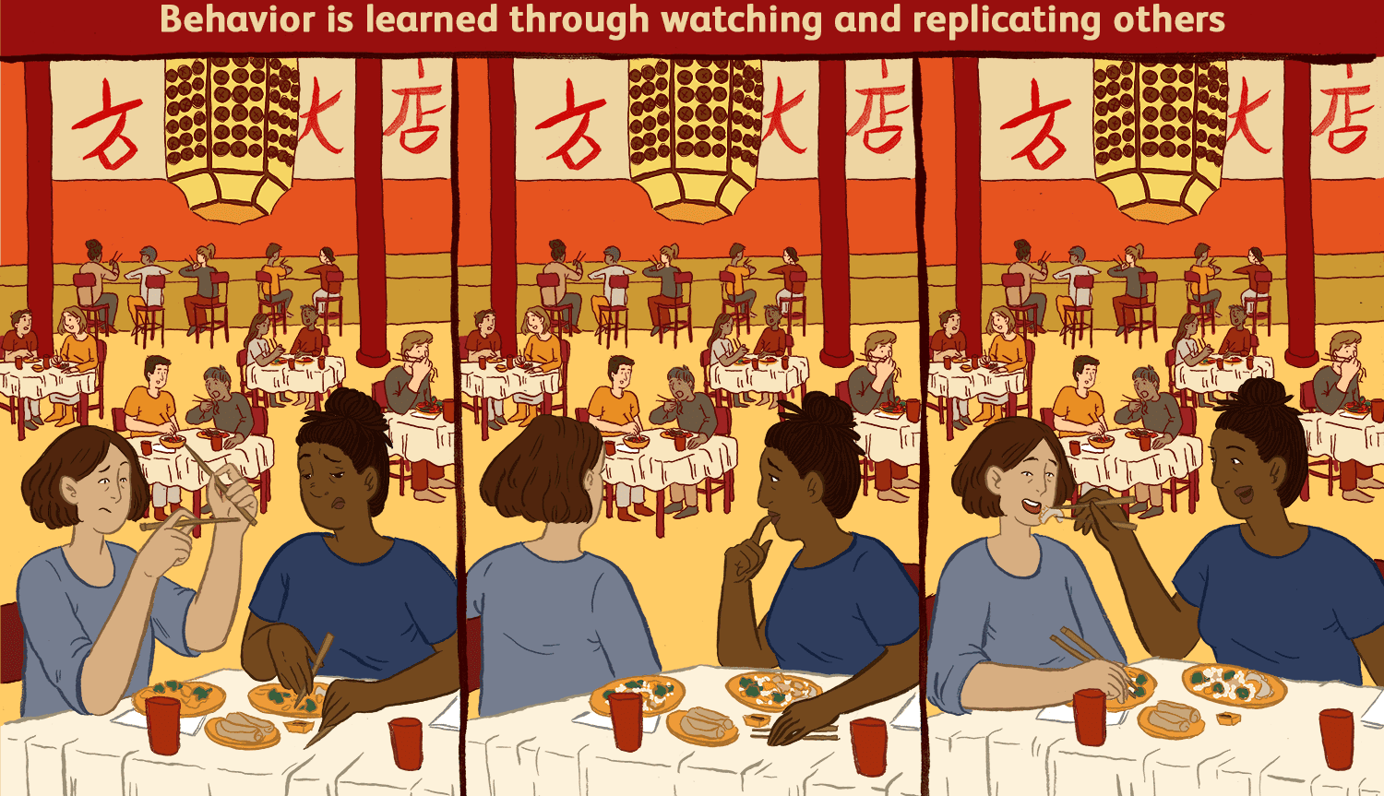

Slide 18
Observational Learning
learning from the Behavior and Outcomes of Others
social learning or modelling
Bobo doll experiment
more complex than mere imitation
Process of observational learning
direct your attention
retain some representation
representations into appropriate actions

Slide 19
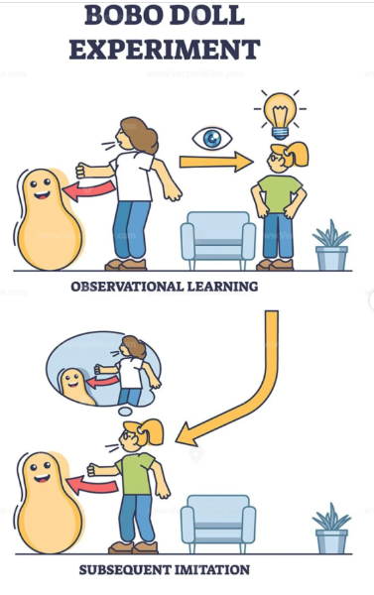

Slide 20
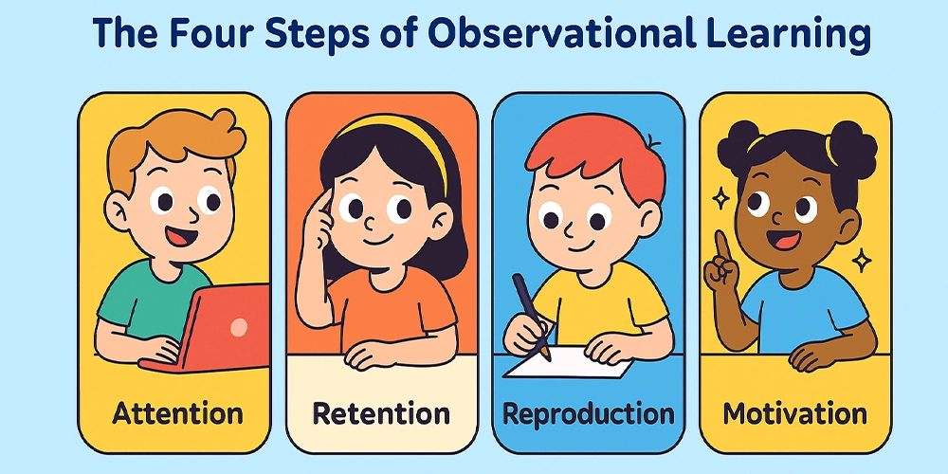

Slide 21
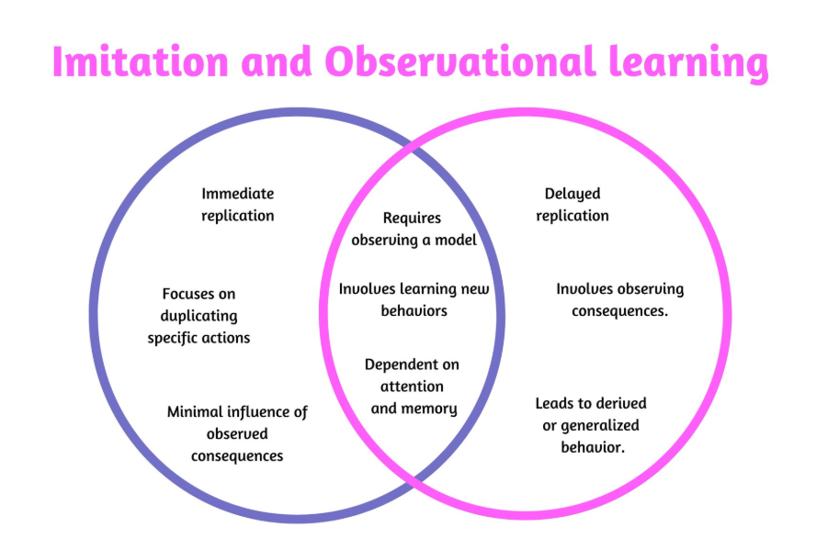

Slide 22
Video
https://www.youtube.com/watch?v=b6t_OTHpJJ0
V3 Observational Learning

Slide 23
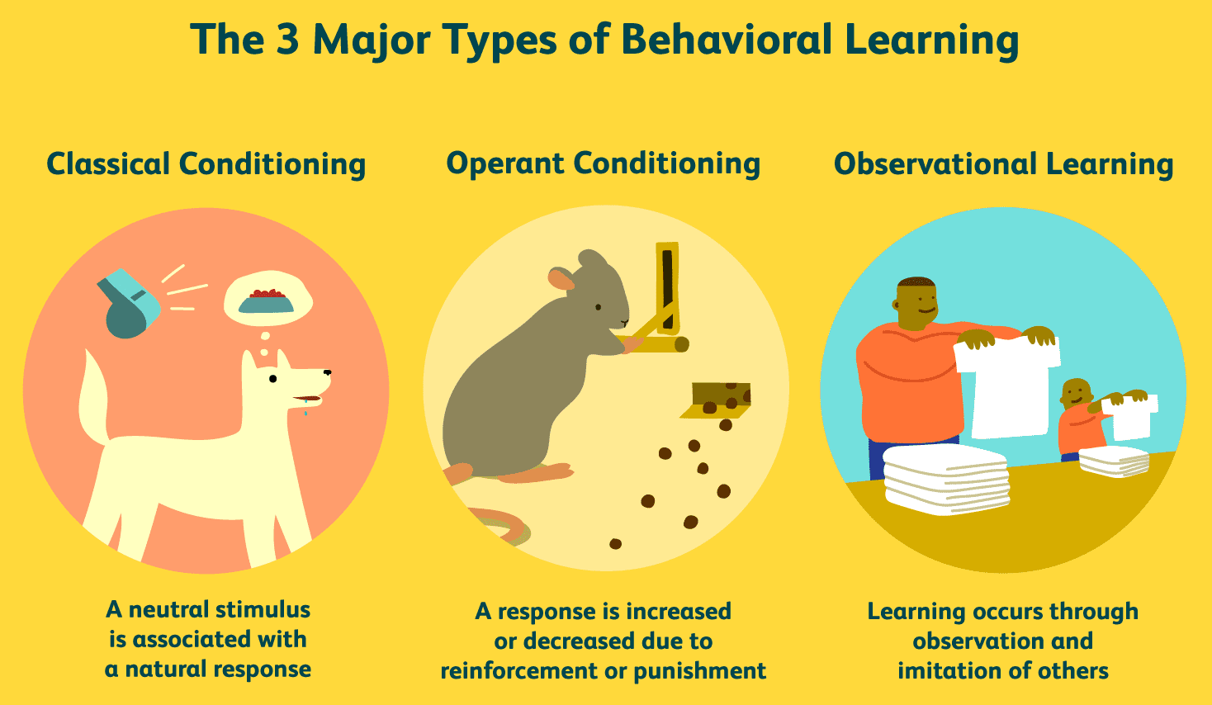

Slide 24
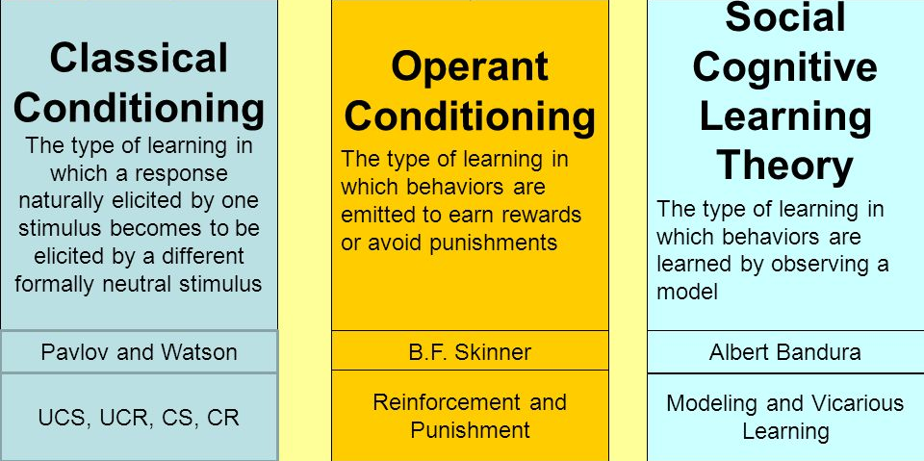

Slide 25
